Slide 1
Ranking FTSE Companies by commitment to diversity

Slide 2
FTSE-100 Diversity Indicators
100 Companies
26 Diversity indicators
These indicators cover areas such as gender representation across employees, management and boards, pay equity measures like gender or ethnic pay gaps, diversity policies such as parental leave, and indicators related to reporting and disclosure.
Examples include:
Female representation in employees, management and boards
Gender pay gap and bonus gap
BAME, LGBT and disability representation
Diversity reporting and policy indicators

Slide 3
methodology
Data Preparation:
The dataset contained missing values where companies had not publicly disclosed certain indicators.
Missing values converted to NaN
Indicator columns converted to numeric format
Missing Indicators treated as zero contribution– WHY? Because non-disclosure reflects lower transparency around diversity metrics, and penalises non-disclosure.
Could there have been any other approach? Yes, There are several ways to handle missing values, including:
excluding missing indicators from the average (but they make companies reporting fewer indicator look artificially better)
imputing values using statistical estimates (but this could introduce assumptions and may distort rankings- this is more common in predictive modeling, not index construction)
separating disclosure into its own score (a separate disclosure score would have been interesting, but the dataset already includes indicators that capture reporting behaviour, like BAME pay gap reporting, LGBT pay gap reporting, and disability pay gap reporting. So disclosure is already part of the dataset. Because of that, the indicators were included directly in the diversity score instead of building a separate disclosure score. Adding another disclosure score would also require deciding how much weight it should have, which would introduce additional assumptions.)

Slide 4
2. Normalising Indicators:
Indicators are measured in different units:
Percentages
Weeks of parental leave
Binary Indicators
To make them comparable, all indicators were scaled between 0 and 1: Min- Max Normalisation
Just to illustrate, if female management representation ranges from 10% to 50% across companies, a company with 30% representation would be rescaled to roughly 0.5 after normalisation.
[Z-score normalization standardizes variables relative to their mean and standard deviation, which is useful for statistical modelling, but it produces values that can be negative or unbounded. For an index designed to rank companies and communicate results clearly, a bounded 0–1 scale is more interpretable.]

Slide 5
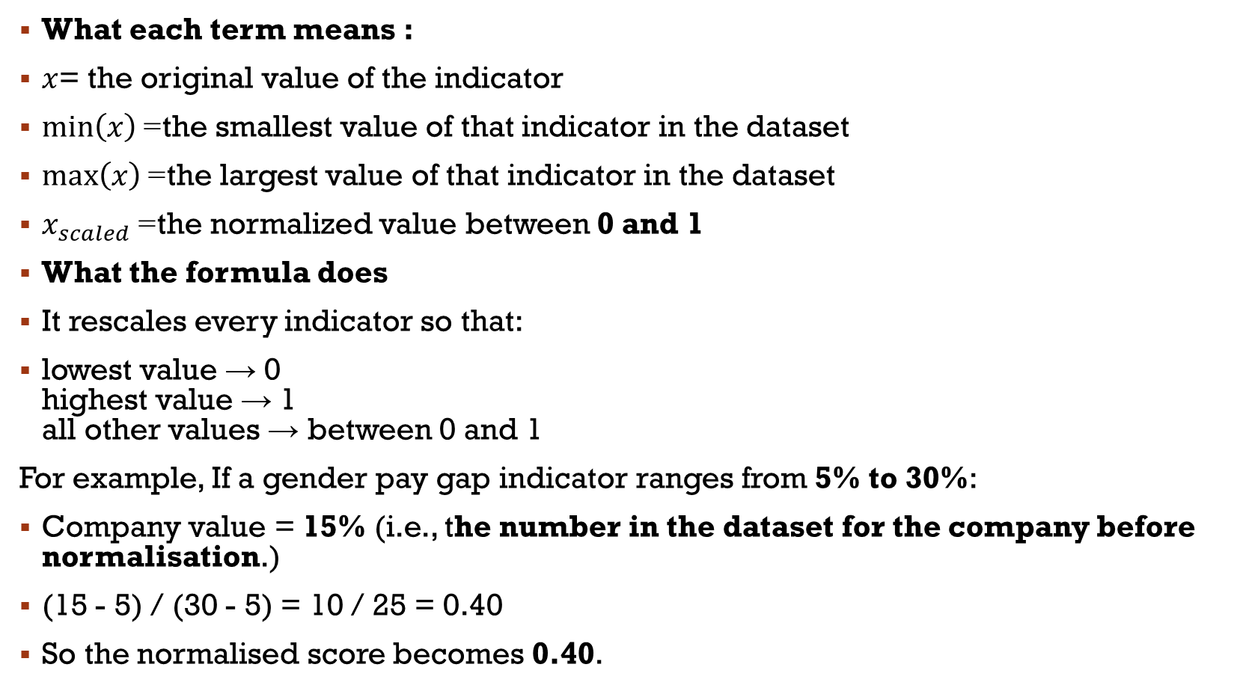
What each term means :
$x$= the original value of the indicator
$min⁡\left(x\right)$= the smallest value of that indicator in the dataset
$max⁡\left(x\right)$= the largest value of that indicator in the dataset
$x_{scaled}$= the normalized value between 0 and 1
What the formula does
It rescales every indicator so that:
lowest value → 0 highest value → 1 all other values → between 0 and 1
For example, If a gender pay gap indicator ranges from 5% to 30%:
Company value = 15% (i.e., the number in the dataset for the company before normalisation.)
(15 - 5) / (30 - 5) = 10 / 25 = 0.40
So the normalised score becomes 0.40.

Slide 6
3. Reversal in Indicators direction:
Some indicators present better outcomes when values are lower, such as:
Gender pay gap
BAME pay gap
LGBT pay gap
Disability pay gap
These were reversed so that higher values consistently represent stronger diversity performance.

Slide 7
4. Constructing the Diversity Score
All normalized indicators were combined using the mean.
Because the dataset does not specify a weighting scheme for the indicators, equal weighting was used to keep the methodology transparent and avoid introducing subjective assumptions.

Slide 8
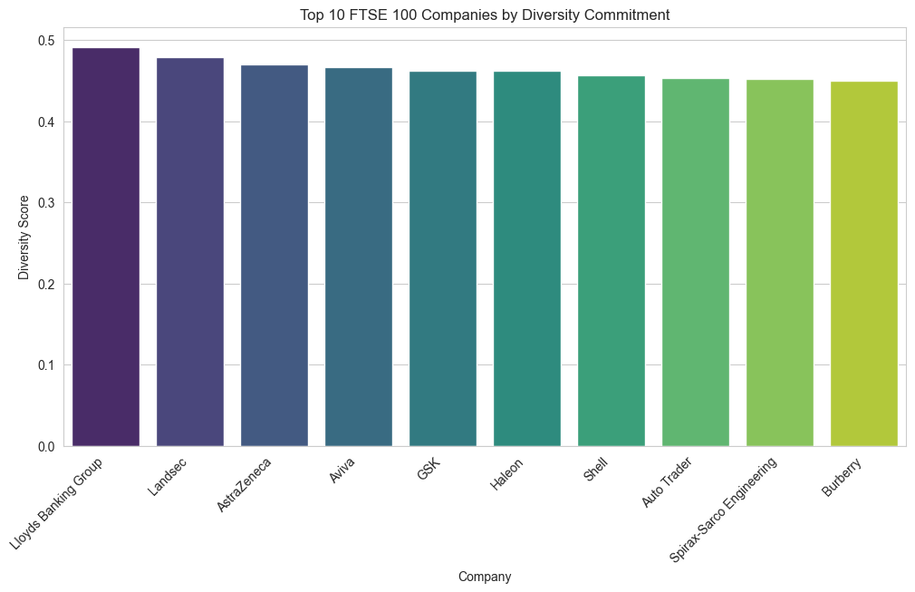
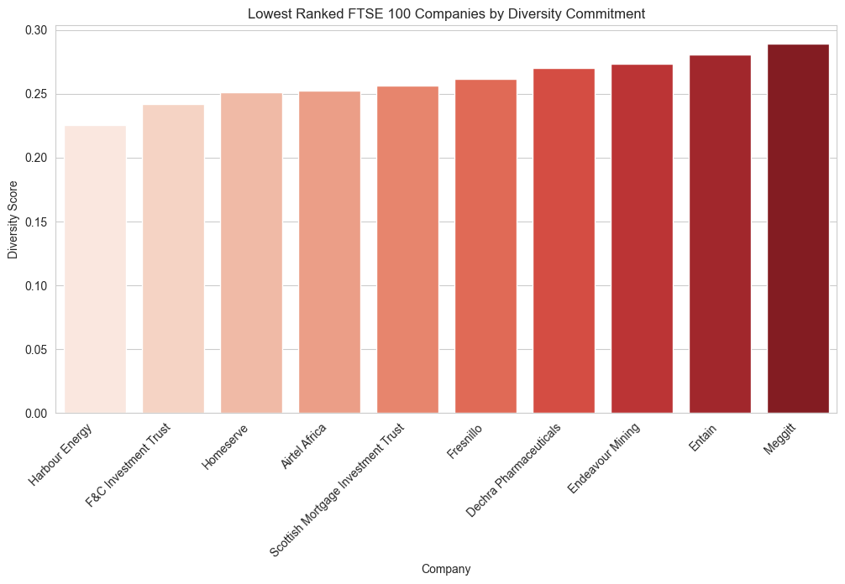
RESULTS
Diversity scores range from ~0.22 to ~0.49
Most firms cluster around moderate scores
A small group performs consistently well across indicators
Several companies score significantly lower, often reflecting limited diversity disclosure or weaker representation indicators

Slide 9
Limitations & Improvements
Limitations
Equal weighting assumption- the index assumes equal importance across indicators.
Missing indicators were treated as zero contribution during scoring so that non-disclosure doesn’t positively affect the diversity score.
Some indicators measure related dimensions of diversity, and can introduce overlap in the composite score.
Some indicators disclose certain diversity indicators, but not others which can affect comparability across firms.

Slide 10
Improvements:
1️⃣ Indicator weighting: Could be grouped into broader dimensions such as representation, pay gaps, policy commitments, and disclosure, with weights assigned to reflect the relative importance.
2️⃣ Separate Disclosure scoring: The future work can try to distinguish between companies that report the value of zero, and those that do not disclose the indicator.
3️⃣ Sensitivity analysis: Can test how rankings change under different weightinh schemes or missing data treatments.
4️⃣ Sub-index scores: Creating sub-scores for dimensions can make it more interpretable.

